Slide 1
회사소개
product
ANC 개요
dual channel KANC-23 소개
구성도
성능동영상
제품사양(표)
응용분야
application area with photo
회사소개

Slide 2

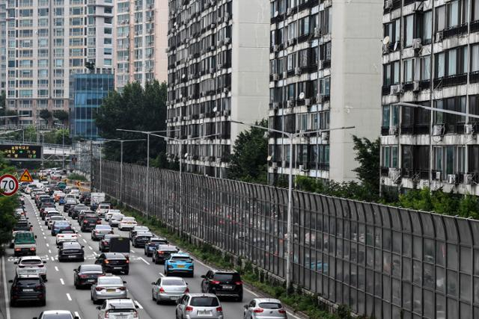
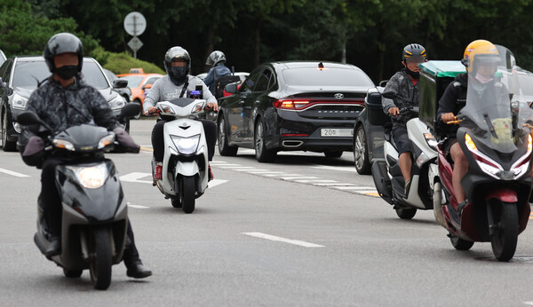
소음공해 noise pollution
https://www.hankookilbo.com/News/Read/A202006251722000010
https://m.idsn.co.kr/news/view/1065598096132836#_PA
연합뉴스 출처 : 매일안전신문(https://m.idsn.co.kr)
소음공해와 인체영향

Slide 3
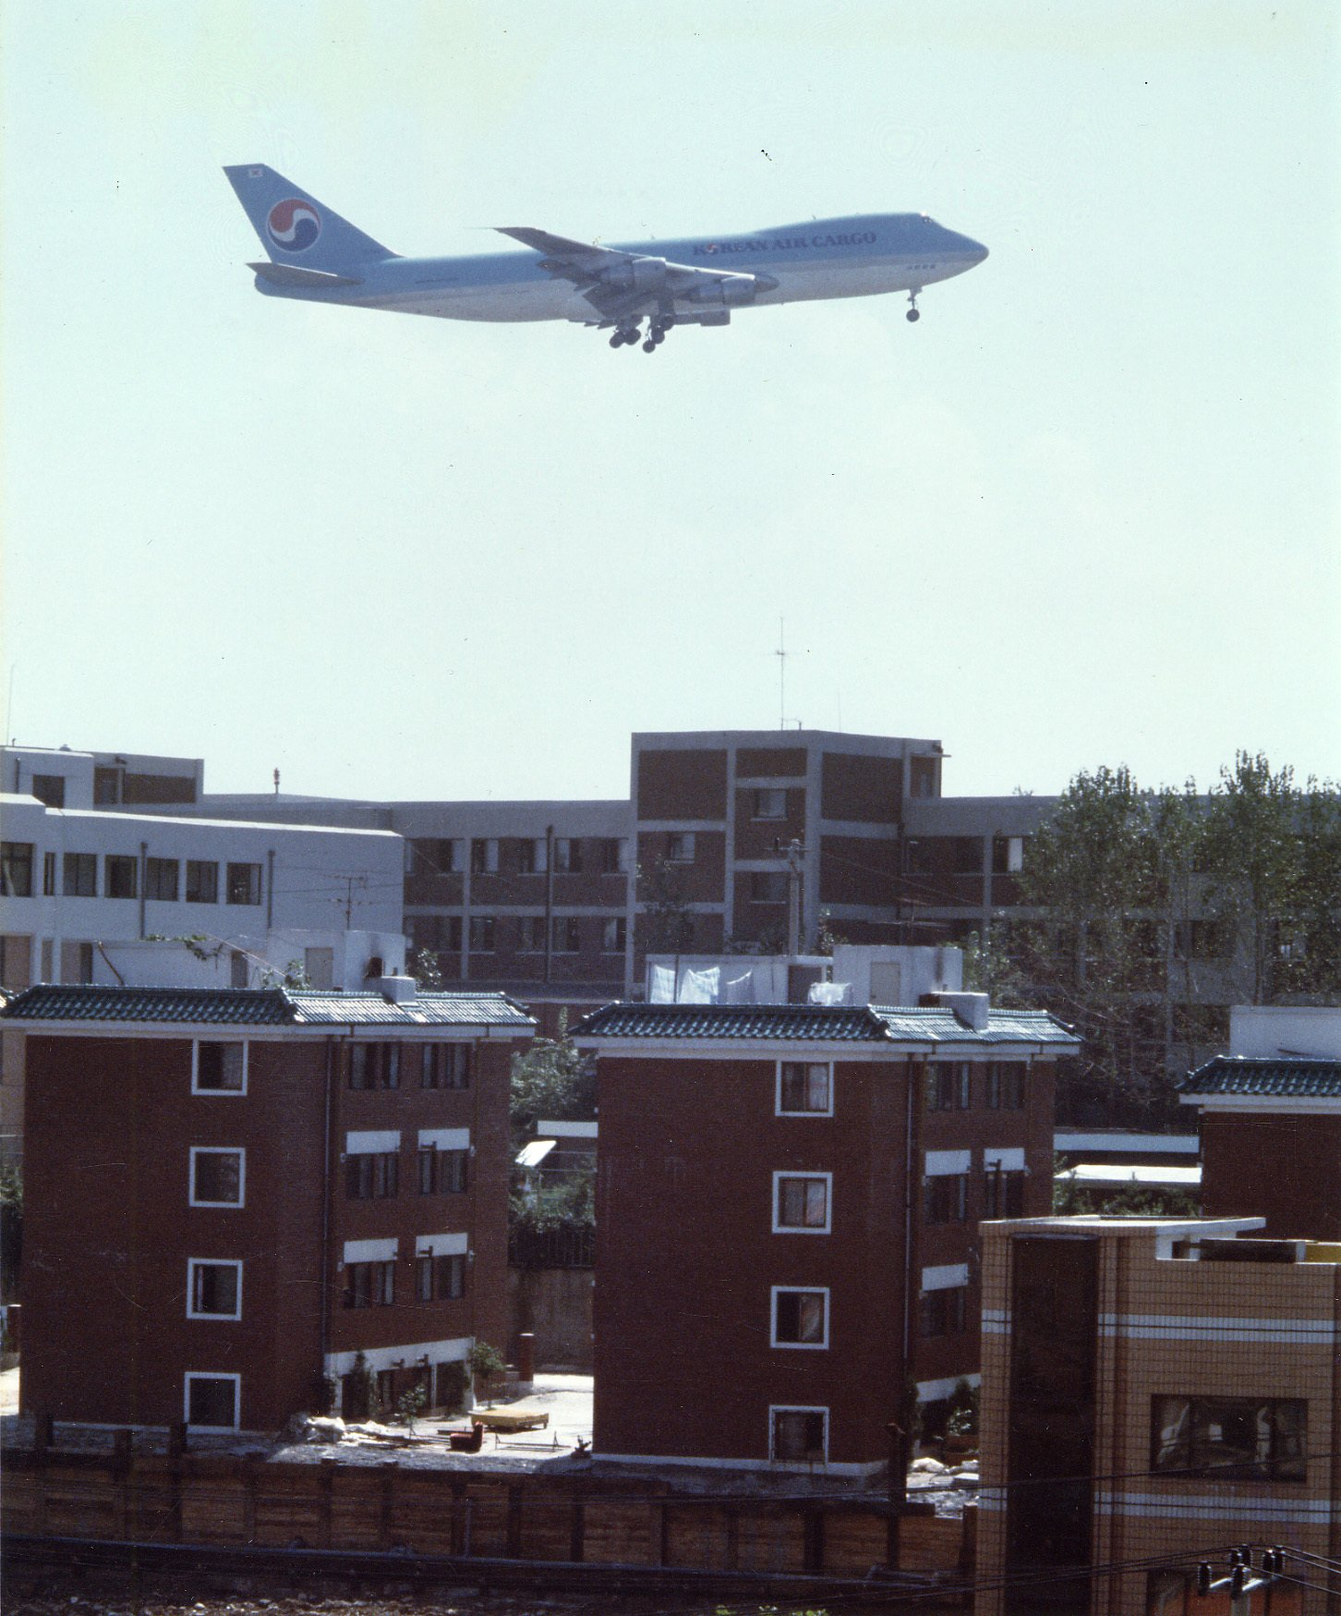
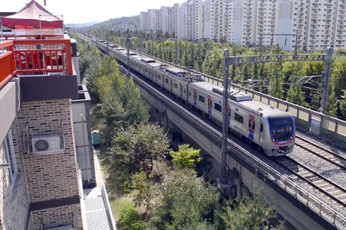
중앙일보 2021.11.10
https://www.joongang.co.kr/article/25022514#home
https://www.chosun.com/site/data/html_dir/2016/10/10/2016101001544.html

Slide 4

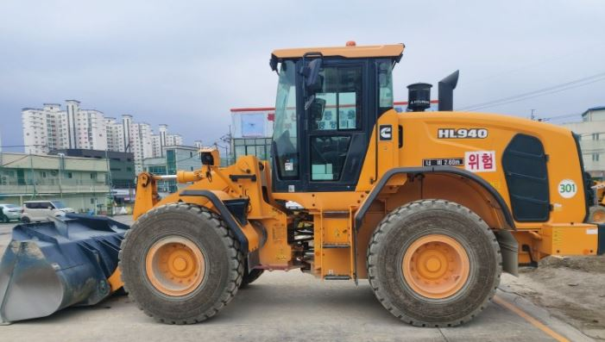
http://www.ecobs.co.kr/news/articleView.html?idxno=29175
https://www.youtube.com/watch?v=vvK18bjlVP4
방음벽 60, 방음터널 44 학교보건법 시행규칙 기준 55dBA

Slide 5
소음공해와 인체영향

Slide 6
We can not prohibit noise generation, but we can reduce noise pollution.
anc 원리

Slide 7
TECZANG
KANC23
blockdiagram
performance movie
specification

Slide 8
Long-term exposure to either occupational or environmental noise can lead to a series of diseases, both auditory and non-auditory[1,2,3]
Zhou, X. & Merzenich, M. M. Environmental noise exposure degrades normal listening processes. Nat. Commun. 3, 843 (2012).
2. Stansfeld, S. A. & Matheson, M. P. Noise pollution: non-auditory efects on health. Br. Med. Bull. 68, 243–257 (2003).
3. Stansfeld, S. et al. Aircraf and road trafc noise and children’s cognition and health: a cross-national study. Lancet 365, 1942–1949 (2005)

Slide 11
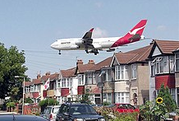
[달콤한 사이언스] 도로 소음 공해가 학생 지적 능력 떨어뜨린다
Life and Noise
https://www.seoul.co.kr/news/newsView.php?id=20220605500072
noise pollution, noise disturbance
PLOS ONE 2022 June 3
숙면방해
기억력과 주의집중력을 저하시키고
전반적인 인지 발달을 방해
Noise Sources
Traffic Noise
Machinery Noise

Slide 12
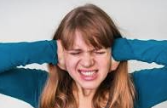
https://nownews.seoul.co.kr/news/newsView.php?id=20200429601013
FASEB Journal 17 April 2020
https://doi.org/10.1096/fasebj.2020.34.s1.04149
소음에 자주 노출될 경우 암에 걸릴 위험이 높아질 수 있다
Prolonged exposure to noise pollution causes an increase in inflammatory signaling in the setting of hypertension
소음 공해에 장기간 노출되면 고혈압 환경에서 염증 신호가 증가합니다.

Slide 13
https://education.nationalgeographic.org/resource/noise-pollution
Noise pollution impacts millions of people on a daily basis. The most common health problem it causes is Noise Induced Hearing Loss (NIHL). Exposure to loud noise can also cause high blood pressure, heart disease, sleep disturbances, and stress. These health problems can affect all age groups, especially children. Many children who live near noisy airports or streets have been found to suffer from stress and other problems, such as impairments in memory, attention level, and reading skill. [National Geographic]

Slide 14
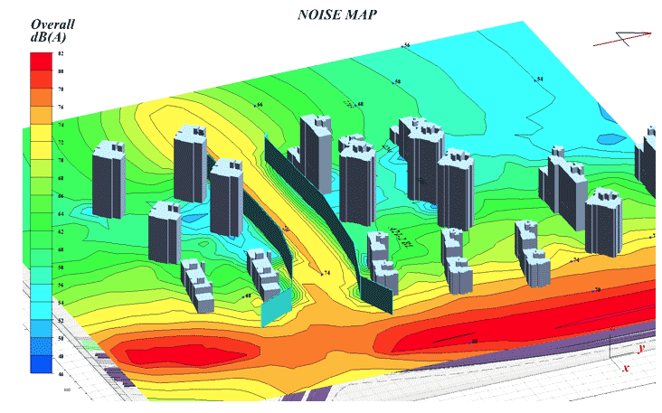
http://sunileng.biz/technote6/board.php?board=photo&page=46&command=body&no=177
성일ENG

Slide 15
https://m.idsn.co.kr/news/view/1065598096132836#_PA
연합뉴스 출처 : 매일안전신문(https://m.idsn.co.kr)

Slide 16
https://www.youtube.com/watch?v=vvK18bjlVP4
방음벽 60, 방음터널 44 학교보건법 시행규칙 기준 55dBA

Slide 17
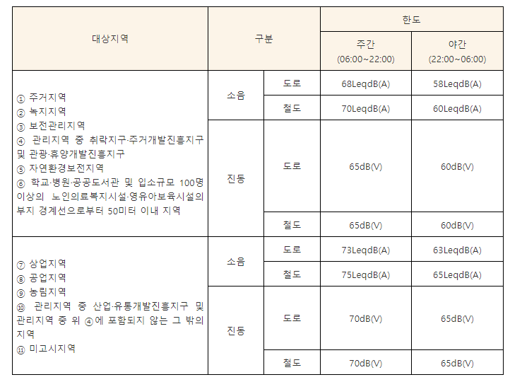
https://www.easylaw.go.kr/CSP/CnpClsMain.laf?csmSeq=1333&ccfNo=3&cciNo=1&cnpClsNo=1

Slide 18
https://www.chosun.com/site/data/html_dir/2016/10/10/2016101001544.html

Slide 19
중앙일보 2021.11.10
https://www.joongang.co.kr/article/25022514#home

Slide 20
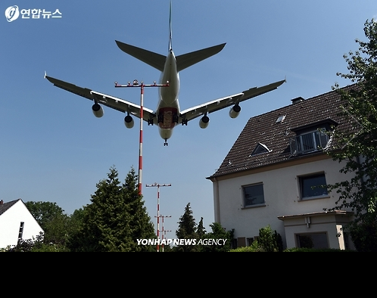
https://www.yna.co.kr/view/AKR20160701152100797
연합뉴스

Slide 21
http://www.ecobs.co.kr/news/articleView.html?idxno=29175

Slide 22
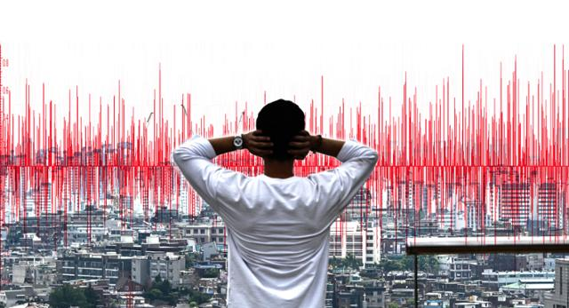
https://www.hankookilbo.com/News/Read/A202006251722000010

Slide 23
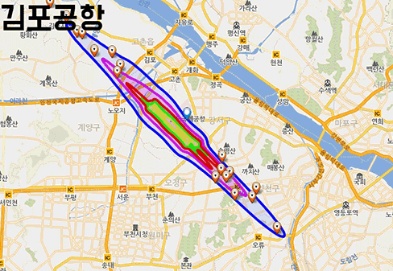
https://www.yna.co.kr/view/AKR20160701152100797

Slide 24

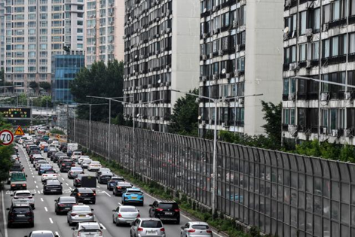




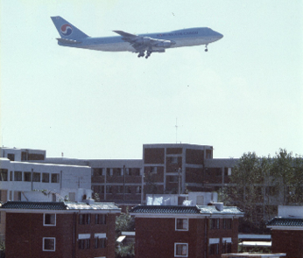


Slide 26
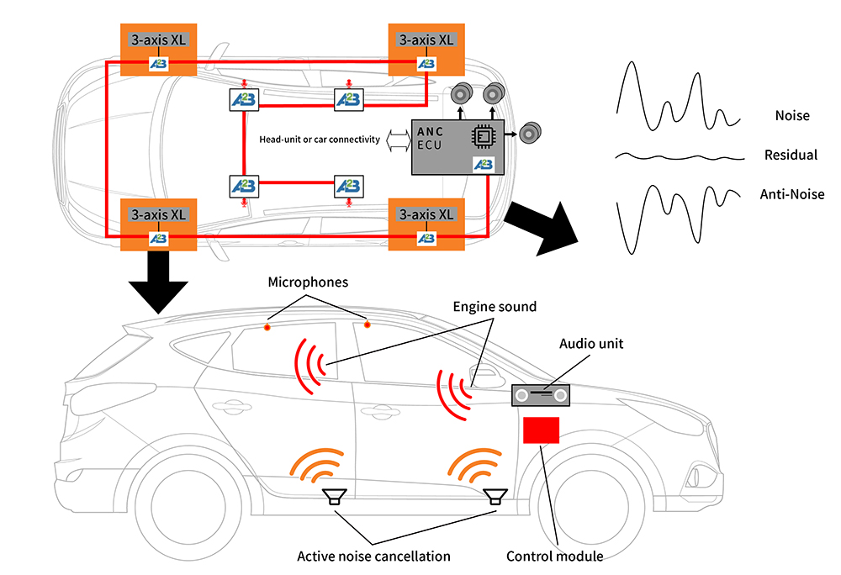
https://news.skhynix.com/anc-technology-your-everyday-life-evolution/

Slide 27
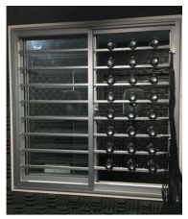
Scientific Reports | (2020) 10:10021 | https://doi.org/10.1038/s41598-020-66563-z

Slide 28
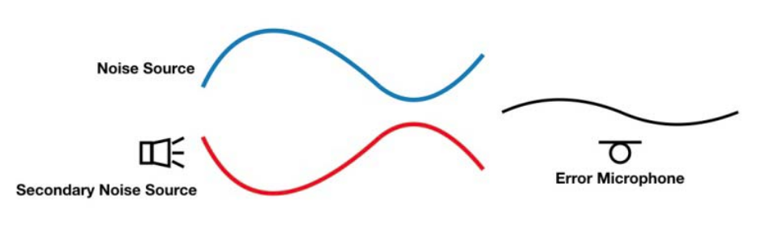
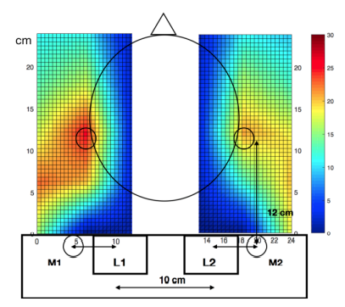
Proceedings, APSIPA Annual Summit and Conference 2018

Slide 29
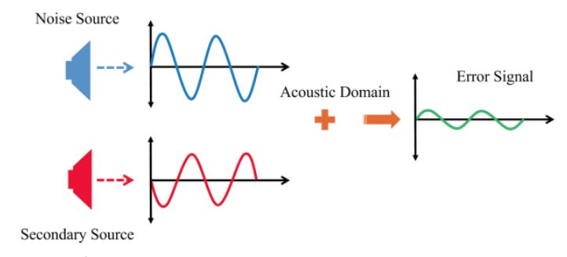



Conference Proceedings of ISEIM 2017
Noise
Acoustic domain
superposition
+ =
ANC
Anti-noise
Noise
Acoustic domain
superposition
+ =
ANC
Anti-noise

Slide 31
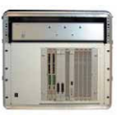
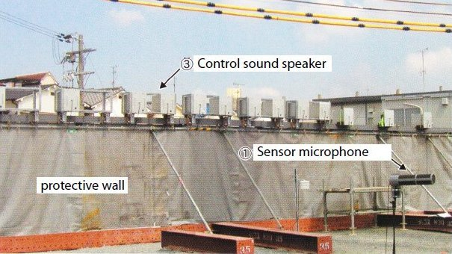
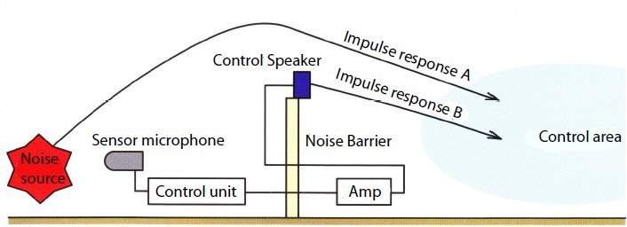
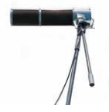
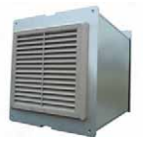
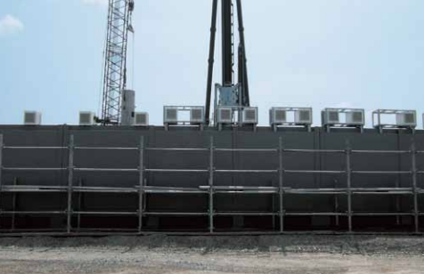
https://fpsinc.co.jp/en/anc/
Possible to reduce a noise level by 10db

Slide 33
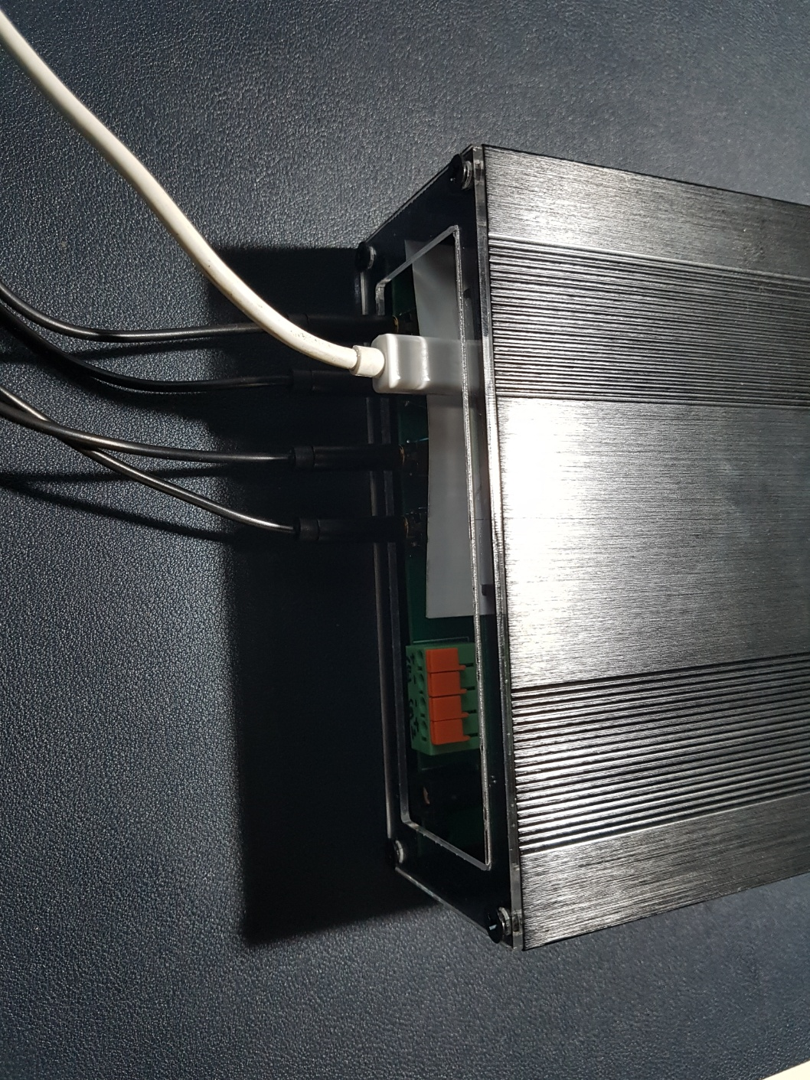
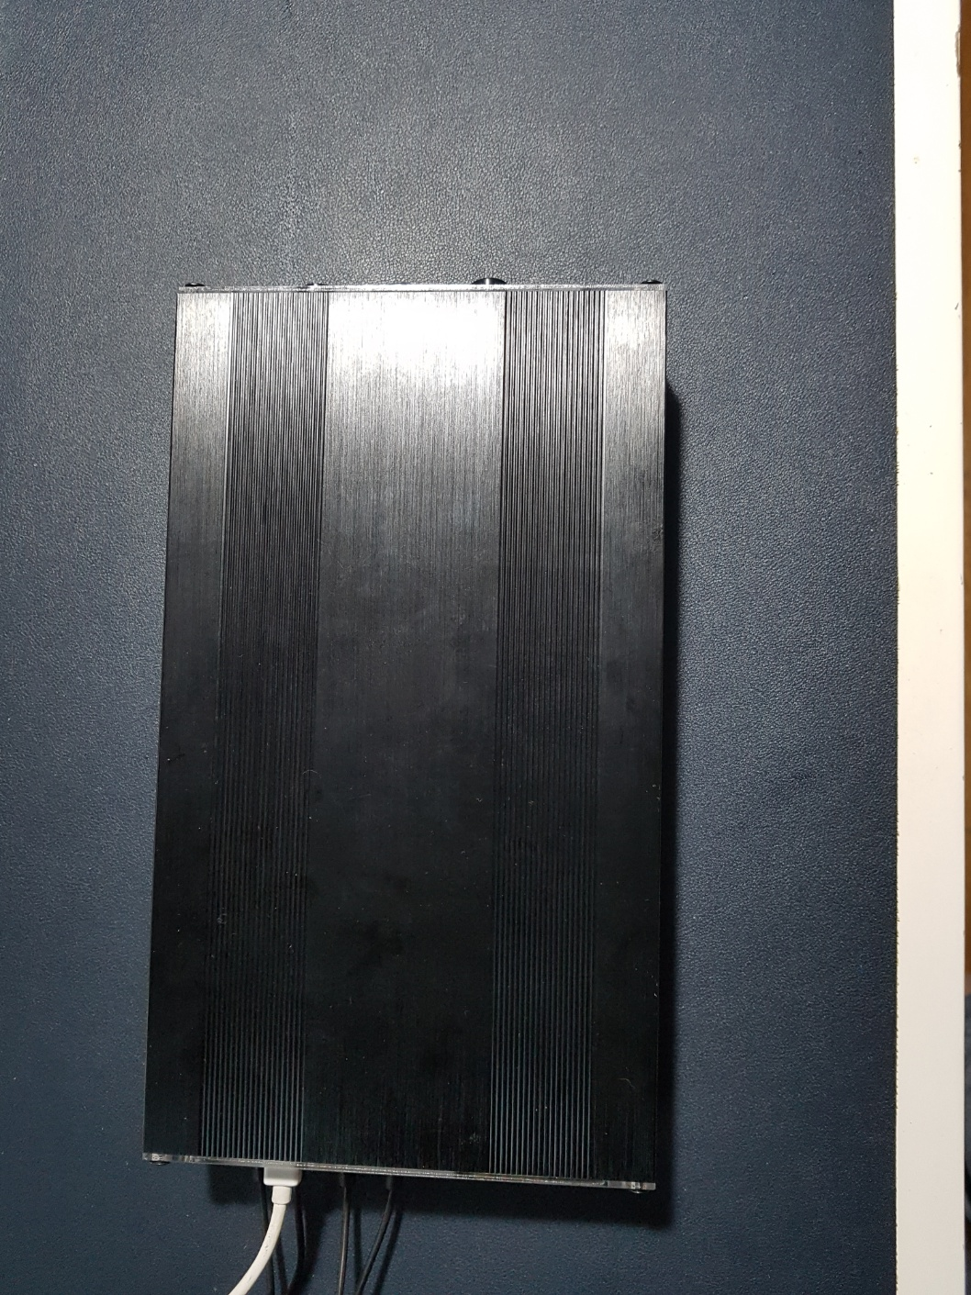
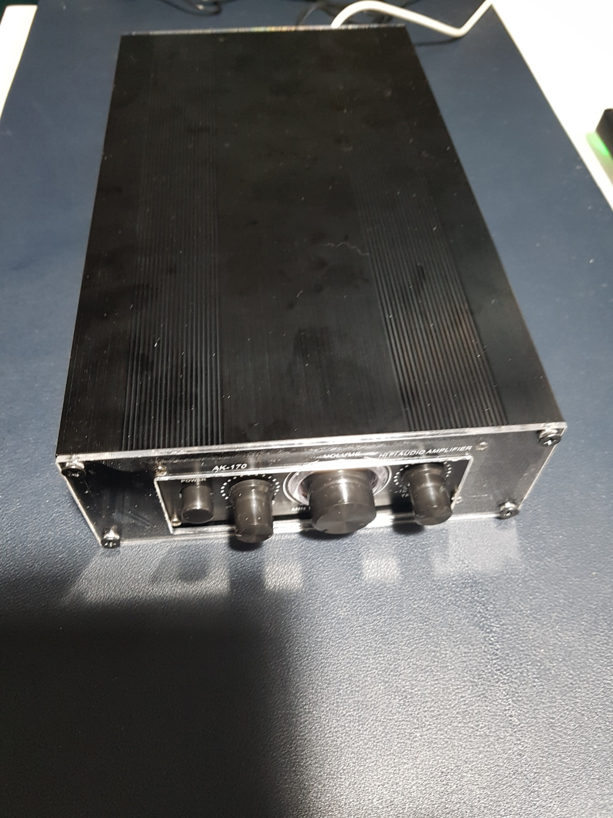
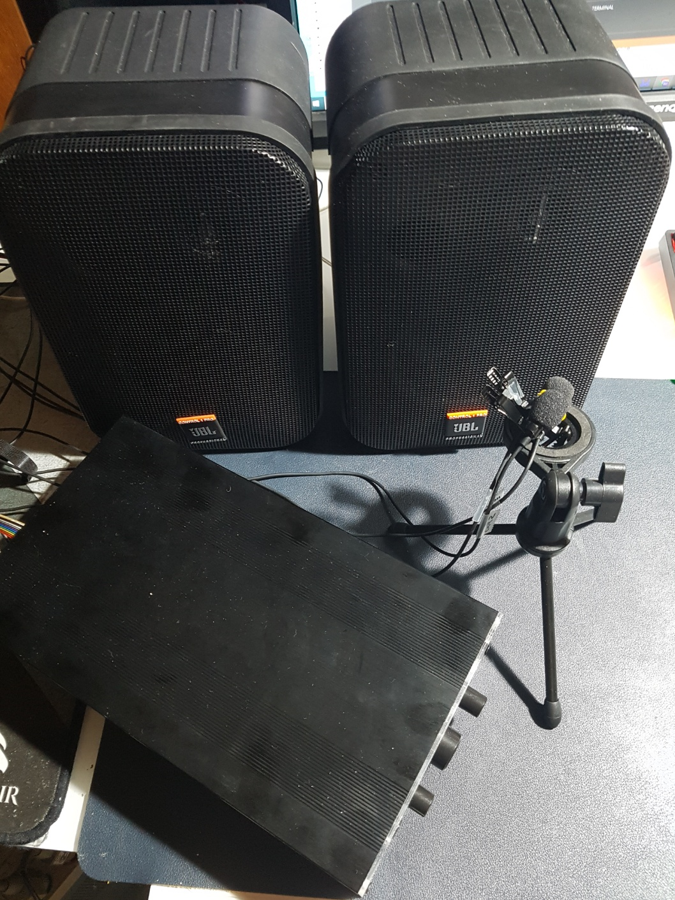
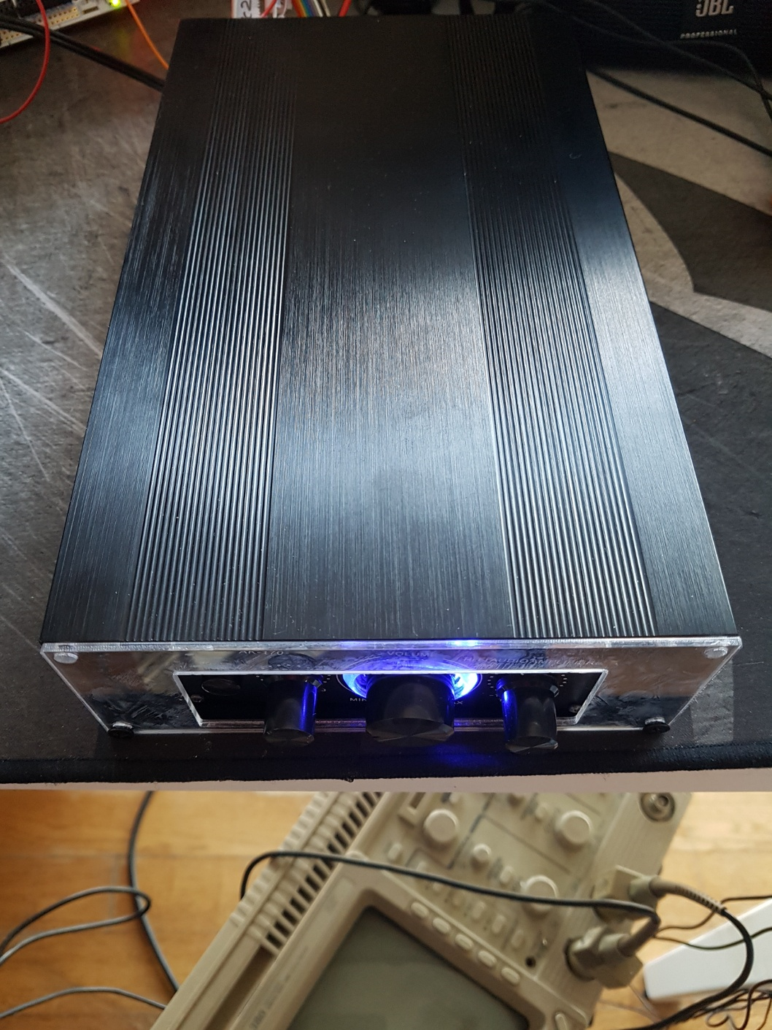

Slide 34
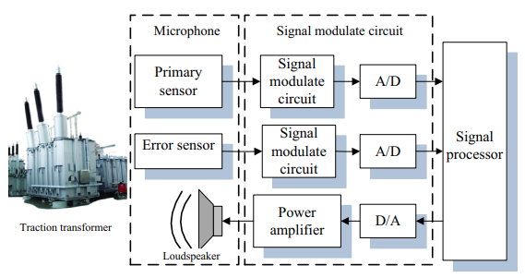
Circuits Syst Signal Process (2017) 36:1586–1603

Slide 35
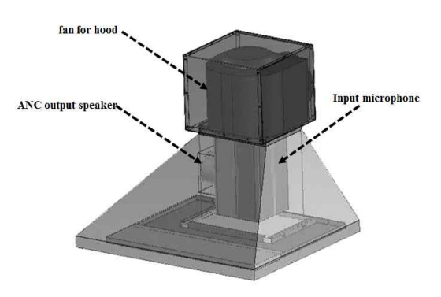
Journal of The Korea Society of Computer and Information Vol. 21 No. 3, pp. 91-96, March 2016
5.6[dB]의 소음을 감소

Slide 36
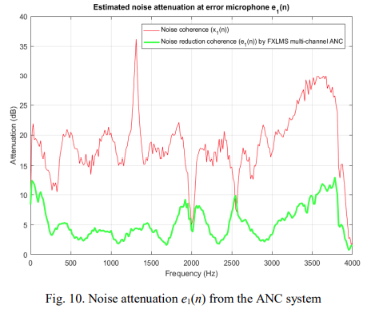
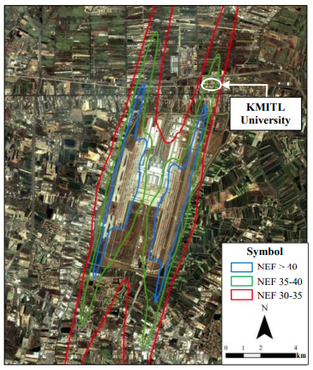
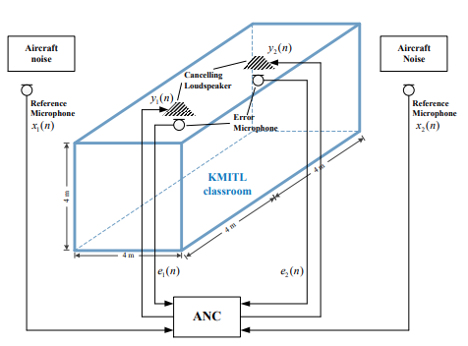
International Journal of Electrical and Electronic Engineering & Telecommunications Vol. 8, No. 6, November 2019
attenuate the noise level about 15 dB

Slide 37
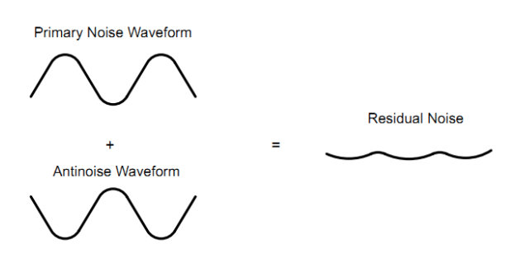
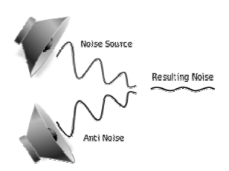

Slide 38
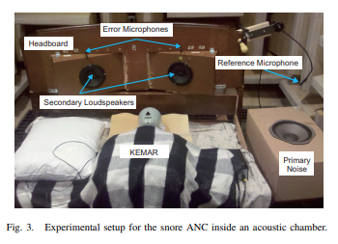
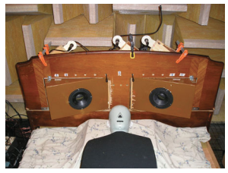
8th International Symposium on Image and Signal Processing and Analysis (ISPA 2013)
noise reduction at the left ear of KEMAR is about 5–10 dB
https://doi.org/10.1017/ATSIP.2012.4 1 Published online by Cambridge University Press
1 × 2 × 2

Slide 39
능동형 방음벽
Active Noise Control Barrier

Slide 40
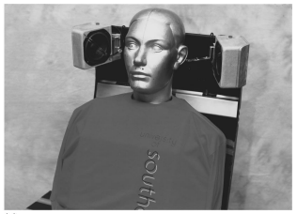
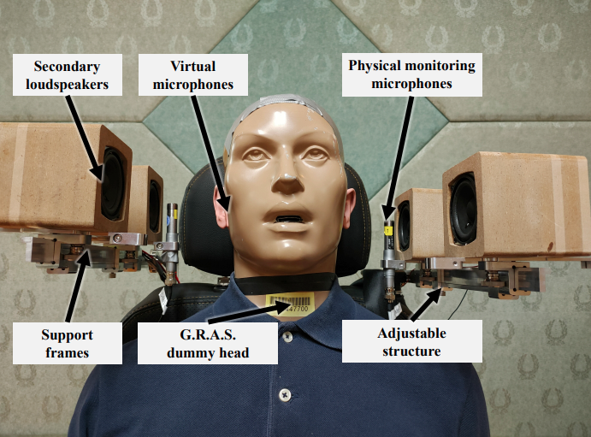
J. Acoust. Soc. Am., Vol. 101, No. 6, June 1997
1997_garcia-bonito1997
too old!!!
noise reduction results using fixed and movable microphone structures were all below 15 dB
Appl. Sci. 2021, 11, 5033

Slide 41
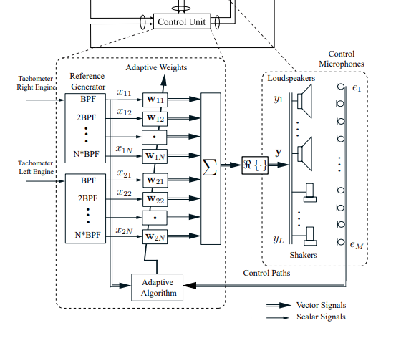
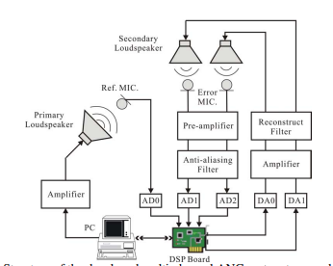
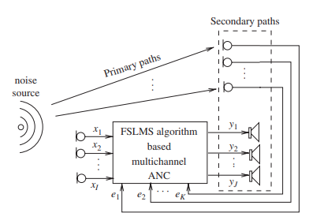

Slide 42
Reference
Microphones
Speakers
Error
Microphones
Pre-
amplifier
Anti-Aliasing filter
ADC
DSP
DAC
Re-construct Filter
Power
Amplifier

Slide 43
